Slide 1


Full Stack-Web Development

Slide 2

HTML Intro
Emmet: Shortcut to write the boilerplate code
Basic Tags
Heading Tags
Paragraph Tags
Div Tags(Generic Containers)

Slide 3
HTML Intro
Difference Between inline and Blocks Elements.
Inline : Occupies only the required space.
eg:Passengers of bus on a road
Block : Occupies the entire width of the viewport.
eg: Passenger of Car on a road

Slide 4
HTML Intro
Some More tags
Strong tag and bold tag
Emphasis tag and italics tag
Span tags
br tag and hr tag

Slide 5
HTML Intro
Escape Characters Code
Unique Character Strings that are otherwise illegal to use.
eg: &gt;/h3&lt;
&copy;
&hearts;

Slide 6
HTML Intro
How to write programming language codes in html
Code tag :Used to define a piece of computer code.
Pre tag : It is used for proper formatting
It overrides the html default formatting

Slide 7
HTML Intro
Difference between Subscript and Superscript
Sub tag : Used to write SubScript
Sup tag : Used to write SuperScript

Slide 8
List : These are of 2 types
Ordered List : Shows proper ordering of elements.
Unordered List : Shows ordering of elements but in symbols.
Items in the list is called list items.
Nesting is possible

Slide 9
Attributes : Extra Information of the browser
Some attr used in unordered list
type=“square” (default : disc)
Some attr used in ordered list:
1.type=“A” (default : 1)
2.start=“21”
3.Reversed (Boolean attr)

Slide 10
HyperLinks/ Anchor Tag
Attribute : target ->default = self
we can change to = _blank
Anchor tag
Level = 0
Level = 1
Lists
Index.html
App.html
Index.html

Slide 11
File Paths
Absolute Path : Links provided Directly
Eg:<<img src=“https://www.w3schools.com/images/picture.jpg”>
Relative Path : Links provided throught relative folders.
Eg:<<img src="/images/picture.jpg>

Slide 12







URL
https://www.google.com/search?q=flipkart
https://www.google.com/search?q=flipkart
1.Protocol
2.Resource
3.Query

Slide 13
Protocol
https://www.google.com/search?q=flipkart
1.mailto : "mailto:abc@gmail.com"
2.Tel : tel:1202029210

Slide 14
Input Tag
https://www.google.com/search?q=flipkart
Attributes:
1.type = text , password, email, date , color , time, range, textArea
2.id= (for labels )
3.placeholder=
Label Tag
Attributes:
1.for= (must be equal to id of input tag)
(refer MDN for more…)

Slide 15
How to make a gender selector?
https://www.google.com/search?q=flipkart
We will use Radio Button.
But using radio button all the elements are getting selected.
Thus, we use the attribute name.

Slide 16
Select Tag
https://www.google.com/search?q=flipkart
1.Use option to enter elements
2.Changing default: use selected(boolean attribute)
Some More Attributes of Input
1.disabled Attribute:
2.Autofocus
3.maxLength in tel attribute
4.type=number -> max and min

Slide 17
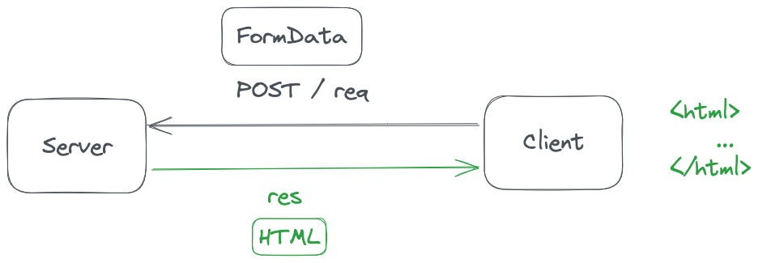
Form
https://www.google.com/search?q=flipkart
Here we have to send data by Server.

Slide 18
Method attribute
https://www.google.com/search?q=flipkart
Get: To get the data
Post: To make changes in the server.
Name attribute
The input value is shown in the query of the url of browser.
In GET we can see the values in the url
In POST method it’s in the Payload.

Slide 19
Method attribute
https://www.google.com/search?q=flipkart
Get: Stored in the format of query-String
Post: Stored in the format of form data.

Slide 20
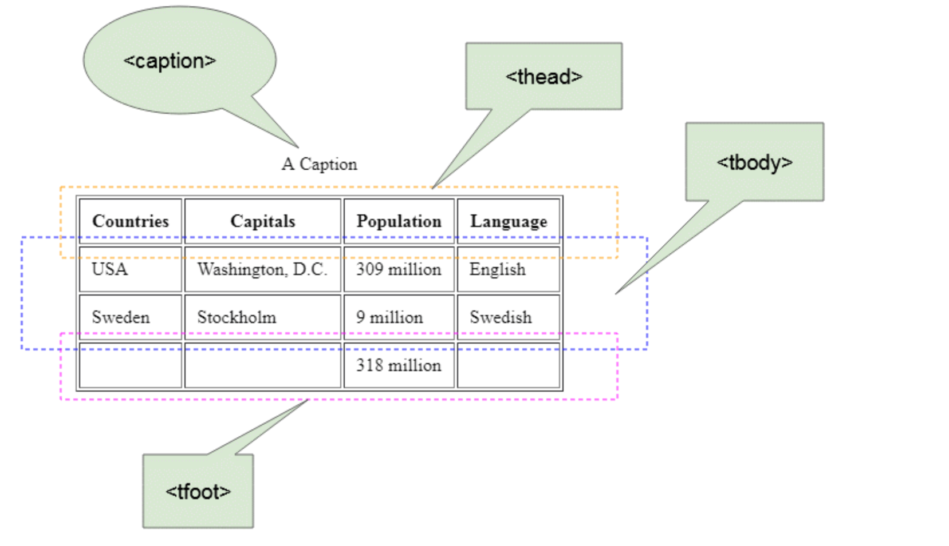
Tables
https://www.google.com/search?q=flipkart

Slide 21
Tables
https://www.google.com/search?q=flipkart
thead – Head of the table
tbody – Body of the table
tfooter – Footer of the table
tr – Table row
th - Table head (bold , center aligned)
td - Table data

Slide 22
Tables Attributes
https://www.google.com/search?q=flipkart
In table tag
border
cellSpacing
cellPadding
align = “center”
Bgcolor
In table data
1.rowspan
2.colspan

Slide 23
Media Elements
https://www.google.com/search?q=flipkart
1.Image
2.Audio
3.Video
Image attributes
1.Width
2.Height
3.alt

Slide 24
Media Elements
https://www.google.com/search?q=flipkart
Audio attributes
1.Controls
2.autoplay
3.Loop
4.muted
Video attributes
(Same as audio attributes)

Slide 25
Iframes
https://www.google.com/search?q=flipkart
It is used in putting one webpage or media links like youtube inside another webpage.
Used Embedded in Youtube.
Attributes here:
1.width
2.height

Slide 26
Iframes Target
https://www.google.com/search?q=flipkart
_self (default)
_blank
_top
_parent

Slide 27
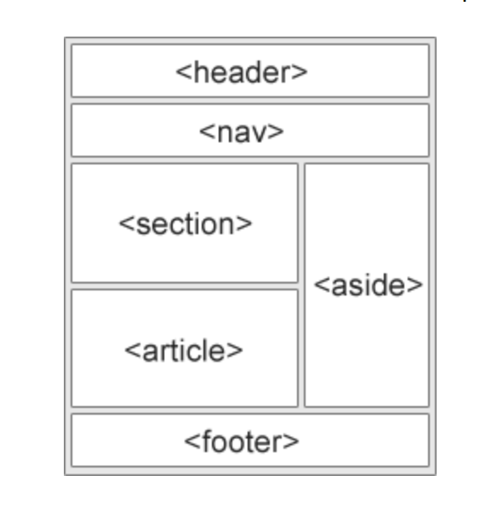
Semantics
A semantic element clearly describes its meaning to both the browser and the developer.
Section: If a item is not being used
again and again.
Article: If a item is being used again
and again.
It is important because of the web
crawlers which determines the SEO of
a web page.

Slide 28
Image Mapping
https://www.google.com/search?q=flipkart
In img use usemap attribute.
map tag : contains name attribute for usemap
area tag : contains the mapped coordinates.
Shape Attribute
1.rect - defines a rectangular region.
2. circle - defines a circular region.
3. poly - defines a polygonal region
4. default- defines the entire region.

